Slide 1
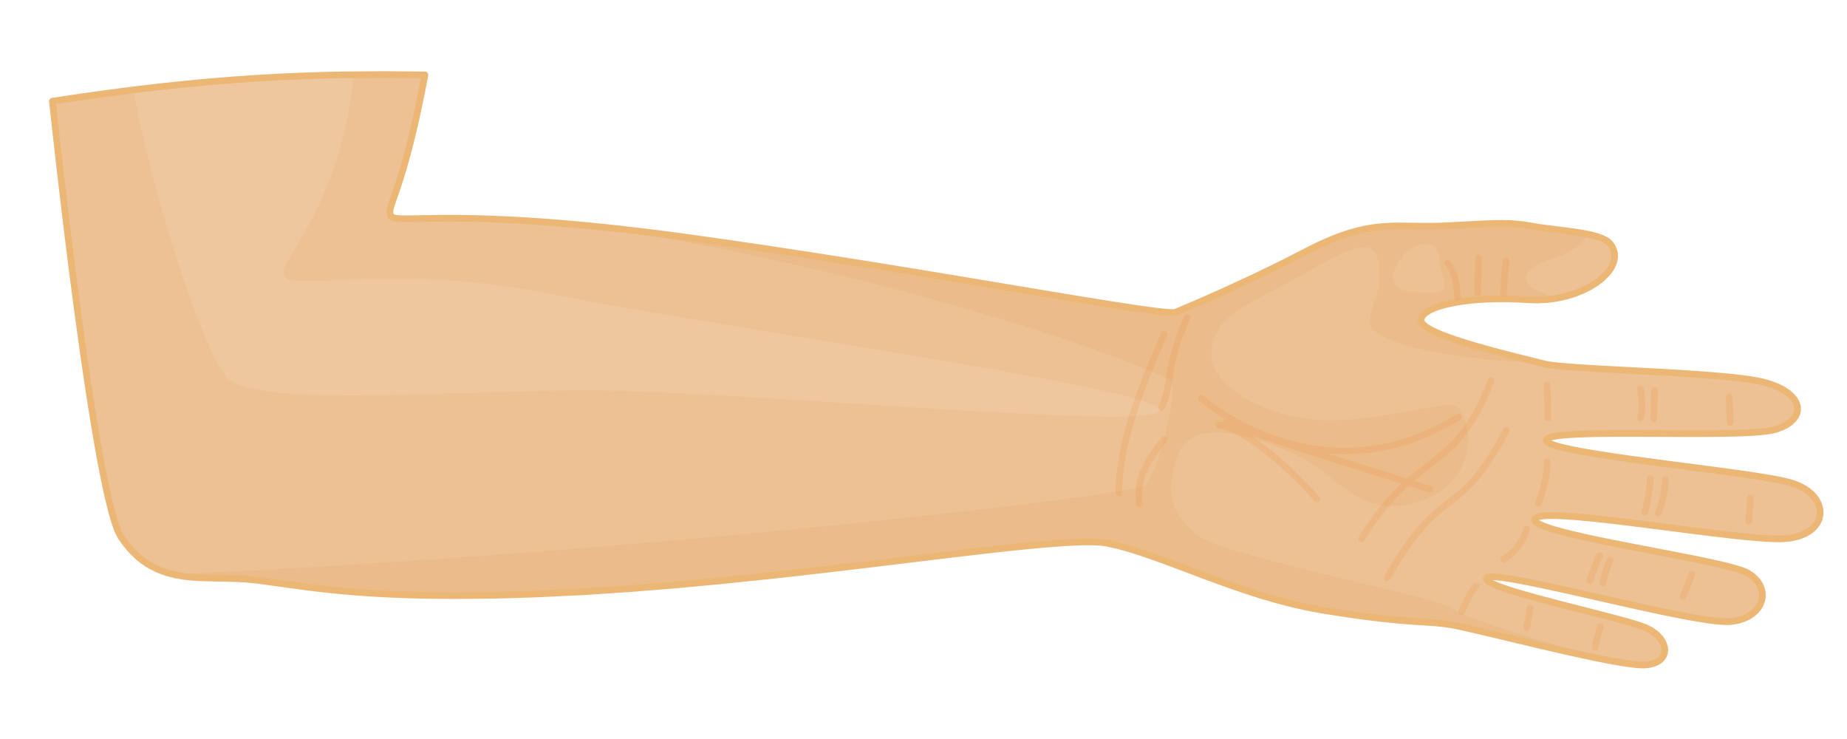
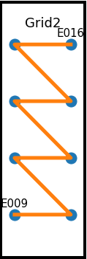
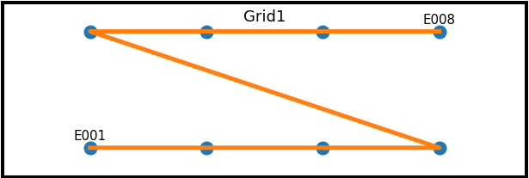
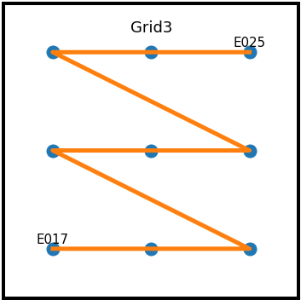
Image source: https://pixabay.com/vectors/arm-hand-person-anatomy-forearm-8213822/
Fine-Wire Electrode
Concentric Needle
Thin-Filament
HDsEMG
Reference Electrode
Ground Electrode

